Slide 1
Use of Artificial Neural Networks to Identify Fake Profiles

Slide 2
Abstract
In this paper, we use machine learning, namely an artificial neural network to determine what are the chances that Facebook friend request is authentic or not. We also outline the classes and libraries involved. Furthermore, we discuss the sigmoid function and how the weights are determined and used. Finally, we consider the parameters of the social network page which are utmost important in the provided solution.

Slide 3
introduction
In today's digital age, the ever-increasing dependency on computer technology has left the average citizen vulnerable to crimes such as data breaches and possible identity theft. These attacks can occur without notice and often without notification to the victims of a data breach. At this time, there is little incentive for social networks to improve their data security. These breaches often target social media networks such as Facebook and Twitter. They can also target banks and other financial institutions.

Slide 4
PROBLEM IDENTIFICATION
The fake profile's contents typically have links that lead to an external website where the damage happens. An unaware curious user clicking the bad link will damage their computer. The cost can be as simple as catching a virus to as bad as installing a rootkit turning the computer into a zombie. While Facebook has a rigorous screening to keep these fake accounts out, it only takes one fake profile to damage the computers of many.

Slide 5
Existing System
The algorithm uses a seed selection method combined with early terminated random walks to propagate trust [5]. Its computational cost is measured in O (nlogn). Profiles are ranked according to the number of interactions, tags, wall posts, and friends over time. Profiles that have a high rank are considered to be real with fake profiles having a low rank in the system. Unfortunately, this technique was found to be mostly unreliable because it failed to take into account the possibility that real profiles can be ranked low and fake profiles can be ranked high.

Slide 6
Proposed System
we use machine learning, namely an artificial neural network to determine what are the chances that a friend request is authentic or not. Each equation at each neuron (node) is put through a Sigmoid function to keep the results between the interval of 0.0 and 1.0. At the output end, this could easily be multiplied by 100 to give us the possible percentage that it is a malicious request. Our solution would be only one deep neural network, meaning it only has a single hidden layer.

Slide 7
Advantages
Vote Trust uses a voting based system that pulls user activities to find fake profiles using trust-based vote assignment and global votes total. It is considered as the first line of defense due to limitations which include real accounts that were already compromised being sold

Slide 8
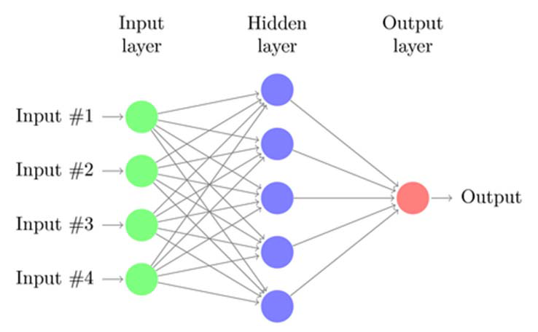
Architecture

Slide 9
Module Details
Admin Module
User Module

Slide 10
Admin Module
Admin Module: Admin will login to application by using username as ‘admin’ and password as ‘admin’ and then perform below actions.
Generate ANN Train Model: Admin will upload profile dataset to ANN algorithm to build train model. This train model can be used to predict fake or genuine account by taking new account test data.
View ANN Train Dataset: Using this module admin can view all dataset used to train ANN model

Slide 11
User Module
Any user can use this application and enter test data of new account and call ANN algorithm. ANN algorithm will take new test data and applied train model to predict whether given test data contains fake or genuine details.

Slide 12
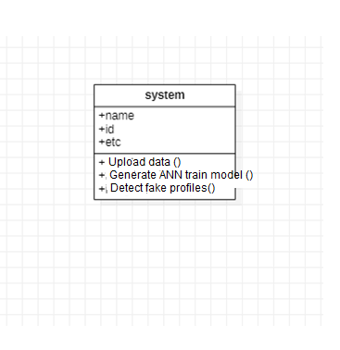
System Design
Class Diagram

Slide 13
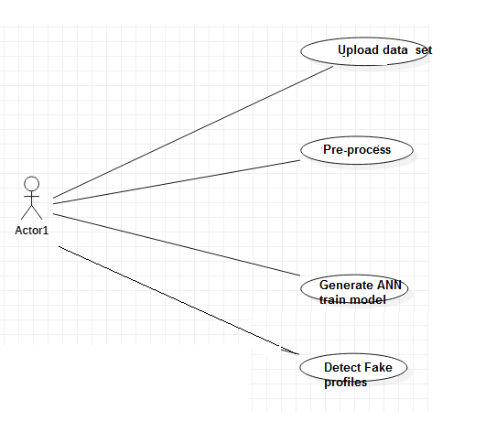
Usecase Diagram

Slide 14
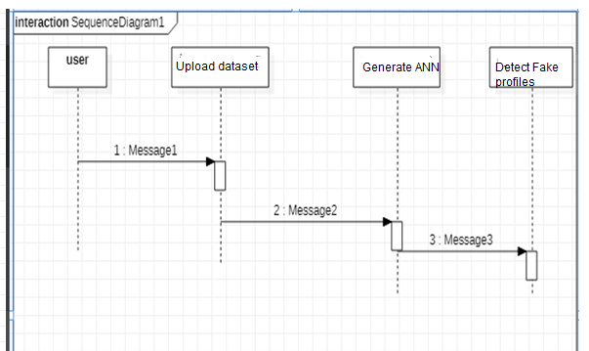
Sequence Diagram

Slide 15
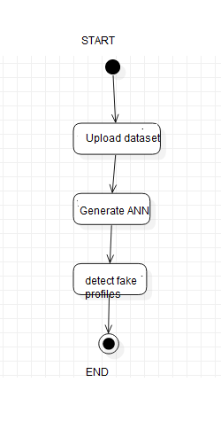
Activity Diagram

Slide 16
HARDWARE REQUIREMENTS
RAM : 4GB and Higher
Processor : Intel i3 and above
Hard Disk : 500GB: Minimum

Slide 17
SOFTWARE REQUIREMENTS
OS : WINDOWS
LANGUAGE : PYTHON 3.7.0
FRAMEWORK : DJANGO

Slide 18
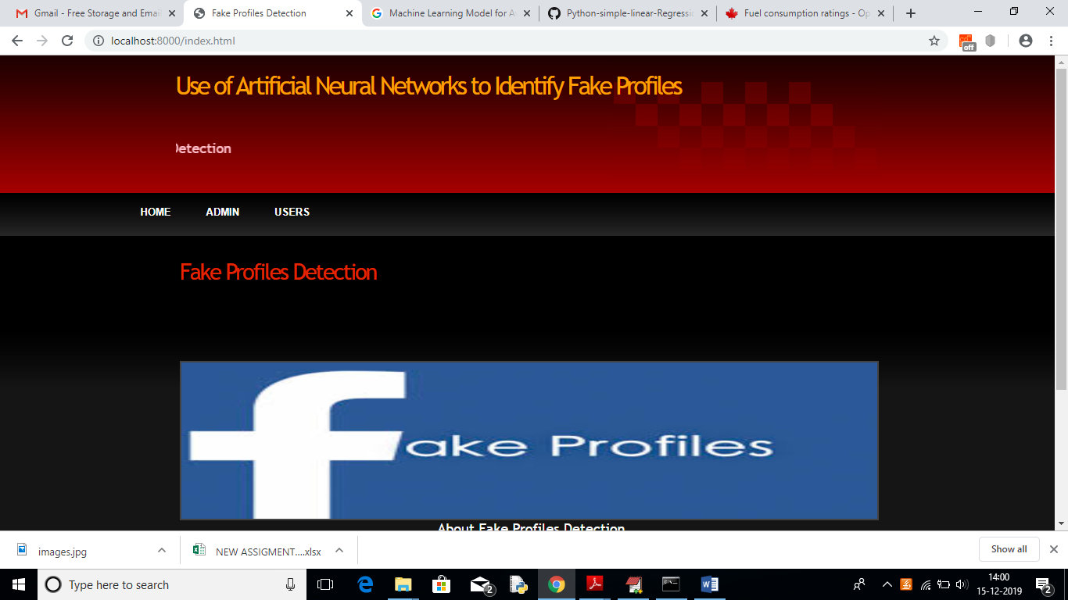
SCREEN SHOTS
Home Page

Slide 19
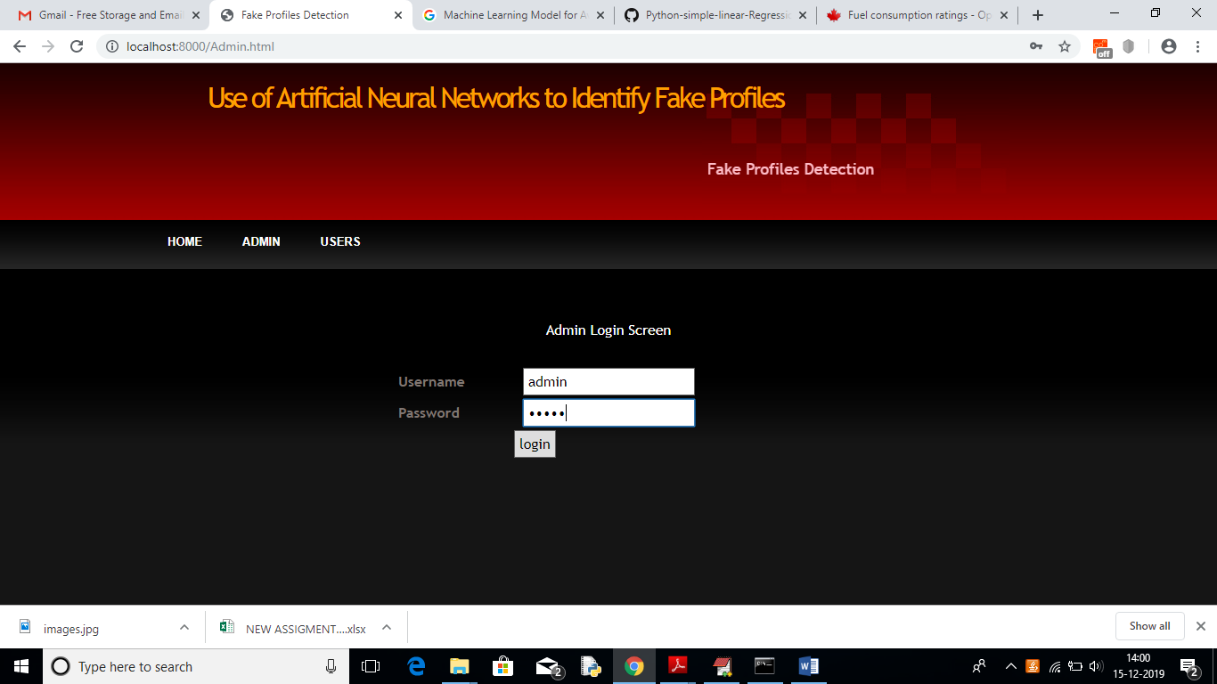
Admin Login Page

Slide 20
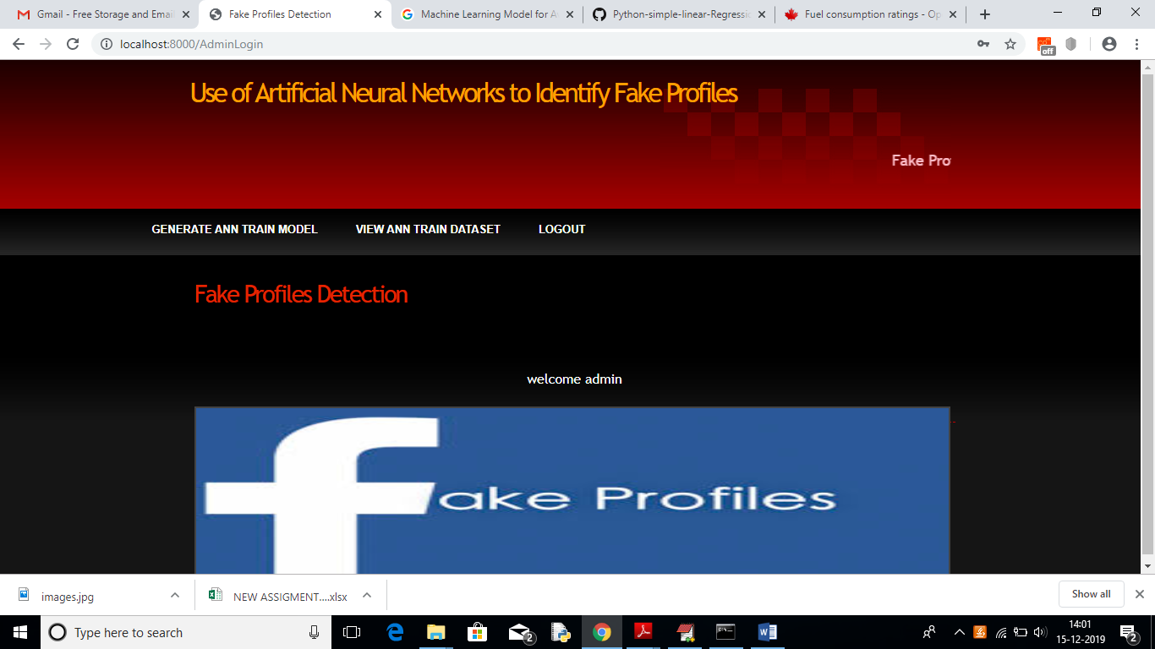
Admin Home Page

Slide 21

Generate ANN Model

Slide 22
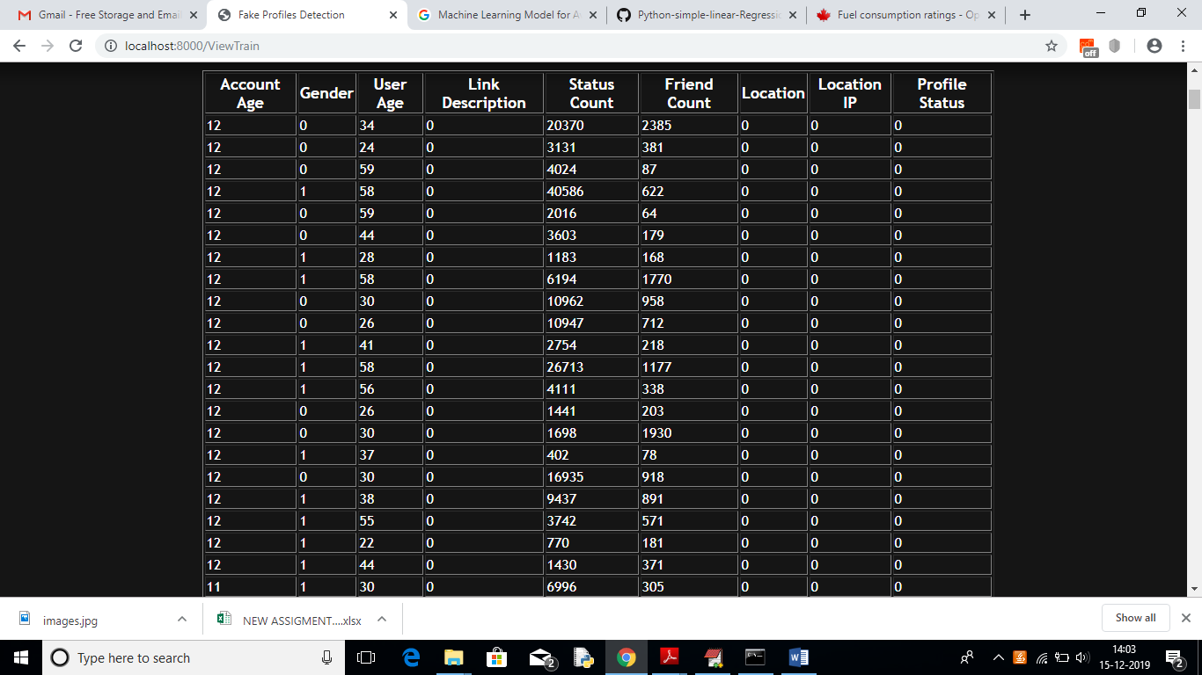
View Dataset

Slide 23
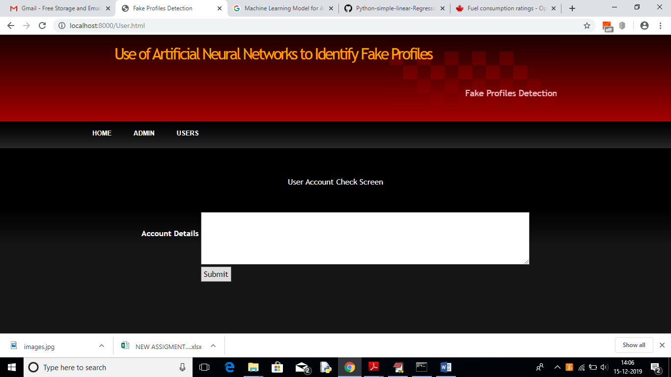
User Check Page

Slide 24
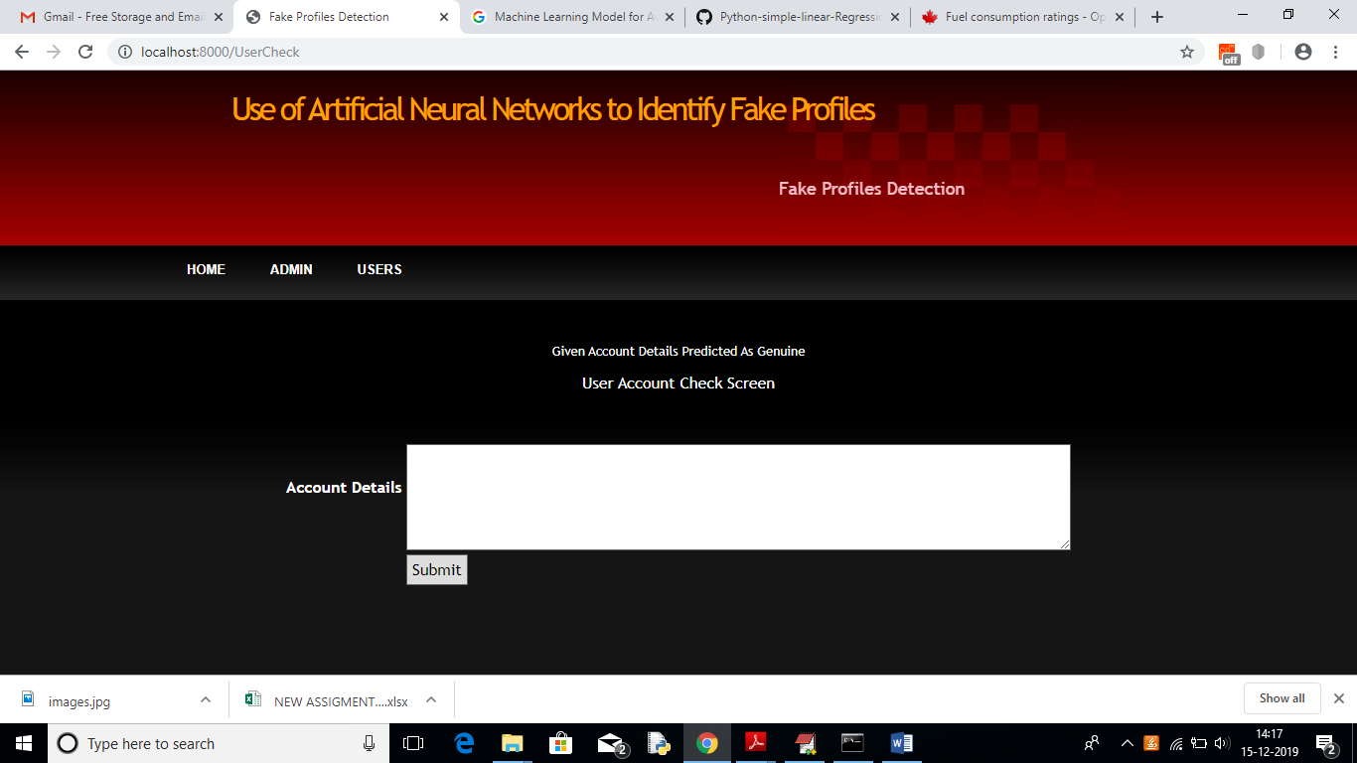
Result Page

Slide 25
CONCLUSION
we use machine learning, namely an artificial neural network to determine what are the chances that a friend request is authentic are or not. Each equation at each neuron (node) is put through a Sigmoid function. We use a training data set by Facebook or other social networks. This would allow the presented deep learning algorithm to learn the patterns of bot behavior by back propagation, minimizing the final cost function and adjusting each neuron's weight and bias.
In this paper, we outline the classes and libraries involved. We also discuss the sigmoid function and how are the weights determined and used. We also consider the parameters of the social network page which are the most important to our solution.

